Slide 1
CS 360 Presentation Oct. 18 NoDD
Andrew Plum and Nathan Nguyen
plum0598@vandals.uidaho.edu
nguy7866@vandals.uidaho.edu

Slide 2
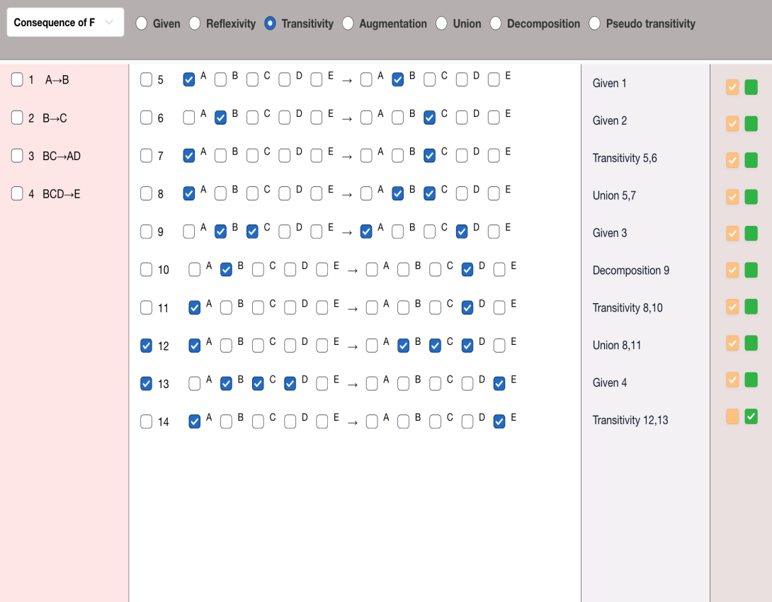
NoDD Grading
Existing User Interface:
Grade student response for:
Logical Consequence of F
Attribute Closure
We are supplied the data, and our work is to evaluate the student submission
Entirely backend work

Slide 3
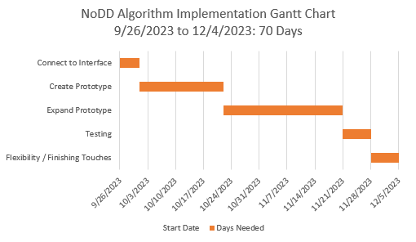
Schedule
On track to meet the deadlines we created.
Slight setbacks
Useless interface
Brainstorming time
F*
Currently:
Integrating prototype with existing interface
Database
Structuring data to feed to functions
Testing

Slide 4
Logical Consequence of F
Check to see if each step on its own is correct
Check to see if student reached the correct answer
Check the last step
How we did it
Applied the definitions to the relevant data for the six inference rules
We did complete this

Slide 5
Attribute Closure
After applying the inference rule definitions for the code in evaluating the student response for the logical consequence of F, we applied all to make a function which determines if step was applicable to one of the 6 inference rules
From here we realized that we could slightly modify this code to make it validate the student’s attribute closure submission.
Currently improving this

Slide 6
To Do
Finish integrating with user interface
Create web page where instructor can turn on grading and see scores

Slide 7
Lets look at the project
https://github.com/NLedge/NoDDx/tree/main
Design questions for you:
For logical consequence of F data tables, we created 2 basis columns What do you think?

